Slide 1
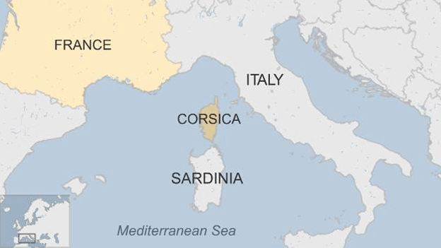
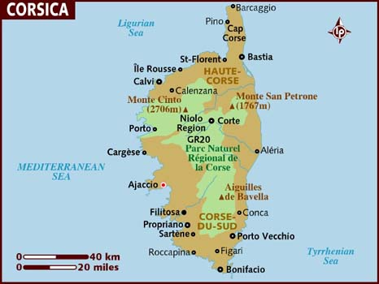
Corsica
Corsica is the most mountainous island in the Mediterranean. It is also the fourth largest island in the Mediterranean, after Sicily, Sardinia and Cyprus. It is 114 miles long and 52 miles wide . Monte Cinto is the highest peak at 8,878 ft. and around 120 other summits are more than 6,600 ft. Mountains comprise two-thirds of the island.

Slide 2
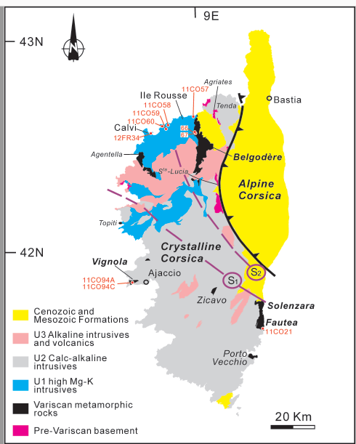
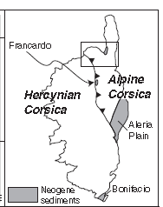
Geology
Notes:
Corsica sprang into being about 250 million years ago, when geological upheavals threw up the mass of granite which forms the backbone of the island
Some 200 million years later the upheavals which brought the Alps into existence also had an effect on Corsica. A mass of sedimentary rock was thrust against the eastern side of the island. The pressures involved causing a metamorphosis into a folded bed of hard, resistant schists Alpine Corsica is a complex stack of nappes derived either from oceanic protoliths (ophiolitic Schistes Lustres) or continental basement (Tenda massif, Corte slices, and Serra di Pigno-Oletta unit). The Schistes Lustres nappes of Alpine Corsica is a stack of oceanic and continental units with a similar organization. Eastern Corsica is the result of this obduction in Eocene times. They were all thrust westward upon the continental Variscan basement of facies rocks of western Corsica (late Variscan granites) to the W and S is 'Hercynian Corsica', dominated by Carboniferous calc-alkaline granitic rocks. The contact between these two major units is tectonic, being marked by a major shear zone produced as the Alpine schists were obducted on to the Hercynian basement during the late Cretaceous.

Slide 3
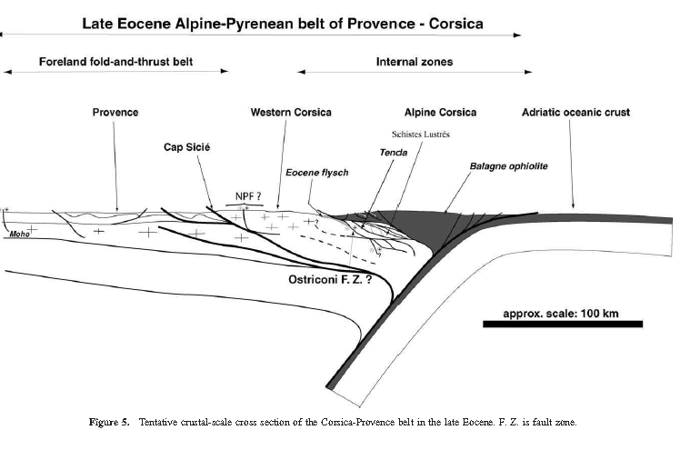
NW
SE
An ophiolite is a section of the Earth's oceanic crust and the underlying upper mantle that has been uplifted (obduction) and exposed above sea level and often emplaced onto continental crustal rocks.
Notes:
Corsica owes its existence to the long collision of Africa with Europe, from around 60 million years ago, the same event that formed the Alps(PDF-link). These mountains on Corsica consisted of older rocks, mainly granite, that formed during a much earlier continent collision. On top of these rode thrust nappes, huge slices of old sediments and basement rocks, pushed up by the collision forces. From around 30 million years ago, the contraction moved to what is now Alps, and the Western Mediterranean sea began to open. Without the confinement, the mountains collapsed, and the thrust nappes dropped down along an enormous fault zone that runs across Corsica from the North to the Southeast. Today, the nappe hodgepodge lies to the East of this zone, while the granite rocks, rid of the burden, floated up on the West side. The highest mountains of Corsica belong to this bounced-up basement, and the GR20 follows it for most of its length. The Adria microplate has been thrust westward onto the Corsican microplate by a distance of at least 150 km. This crustal duplication followed the Late Cretaceous easterly directed subduction of the eastern Corsican continental margin after consumption of intervening Tethyan oceanic crust. The suture zone separating the two micro-plates is delineated by the ophiolite-bearing Schistes lustrés nappe, which suffered a Late Cretaceous HP-LT metamorphism. The Corsican blueschists crystallised during a major thrusting event at depths probably in excess of 35 km, and were overprinted by post-tectonic greenschist facies assemblages at 15-20 km during Late Eocene times. Eventual uplift and exposure of the Schistes lustrés and ophiolites were probably the result of isostatic compensation and erosion during and following their emplacement onto continental basement.

Slide 4
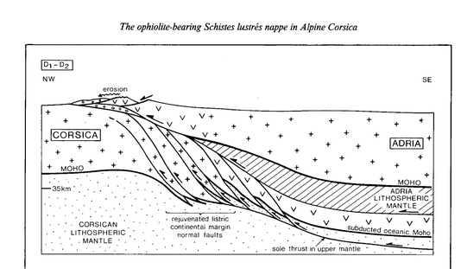
The Alpine schists include various Cretaceous sediments once deposited in the Tethyan Ocean (limestones, pelites, cherts and quartzites) and Jurassic to Cretaceous ophiolites (pillow lavas, gabbros, serpentinites) , as well as detached blocks of strongly deformed Hercynian basement.
Notes:
A nappe or thrust sheet is a large sheet-like body of rock that has been moved more than 2 km (1.2 mi) or 5 km (3.1 mi) above a thrust fault from its original position. Nappes form in compressional tectonic settings like continental collision zones or on the overriding plate in active subduction zones.
During the Cretaceous, Eurasia began to separate from N. America and the relative movement between Africa and Europe became dextral and compressional. It has been suggested (e.g. Zachar , 1979) that about this time an intra –oceanic subduction system collided with the Corsardinian massif
(90-100 Ma) obducting the schists of Alpine Corsica over the Hercynian basement (Mattauer & Proust, 1976). Many of these schists show evidence for several phases of deformation , the earliest of which were the most intense and developed during blueschist facies metamorphism (Du Chaffaut et al. , 1976) . This metamorphism has been dated by radiometric methods ( 40Ar/39Ar and 87R b/86Sr) as 80- 100 Ma (Cohen et al. , 1981; Malu ski, 1977). The schists produced during this event are analogous to the broad belt of coeval schistes lustres of the internal Piedmont Zone of the Western Alps. In particular , the Corsican schistes lustres have been correlated with the Voltri Group which crops out along the Italian coast west of Genoa (du Chaffaut et al., 1972; Moullade , 1978; Messiga et al. , 1983) .

Slide 5
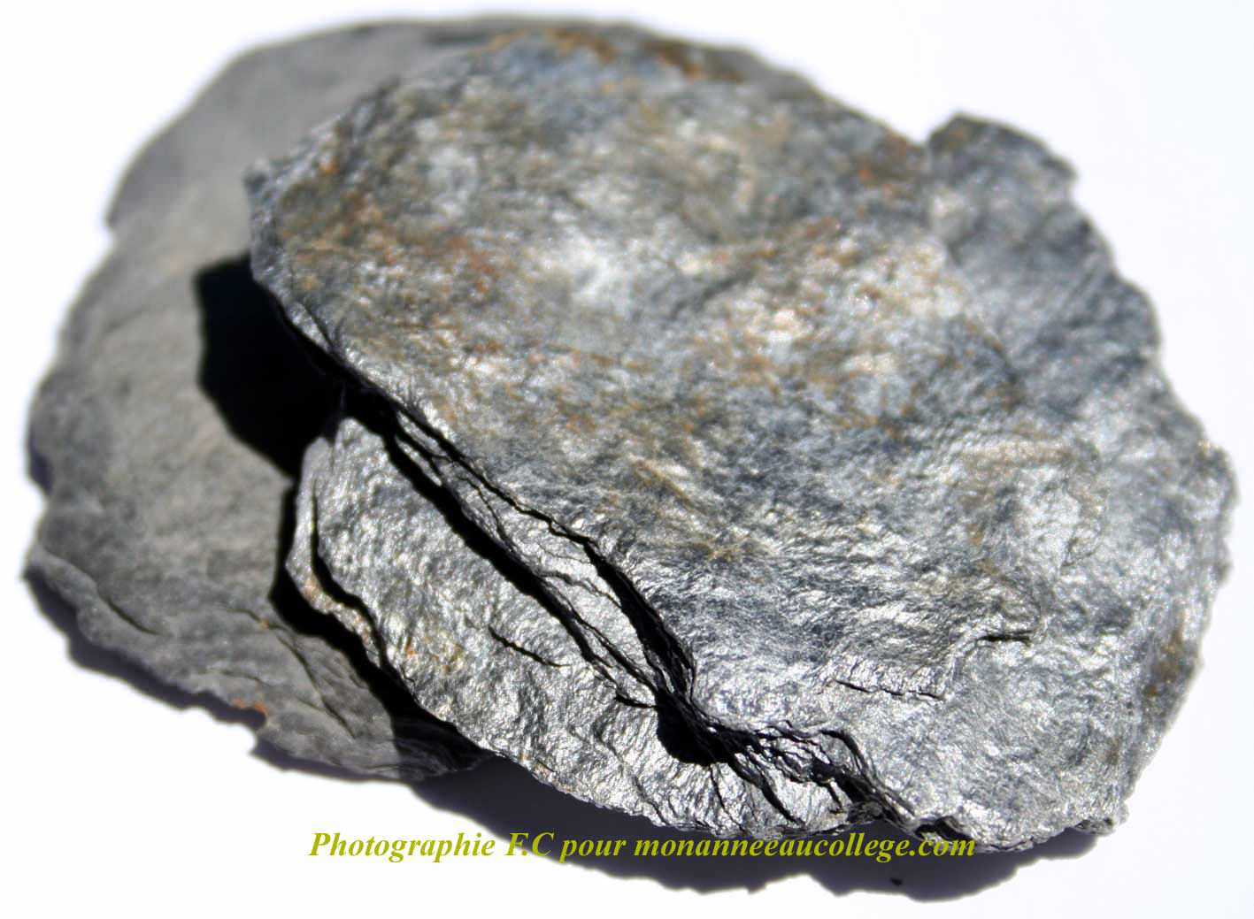
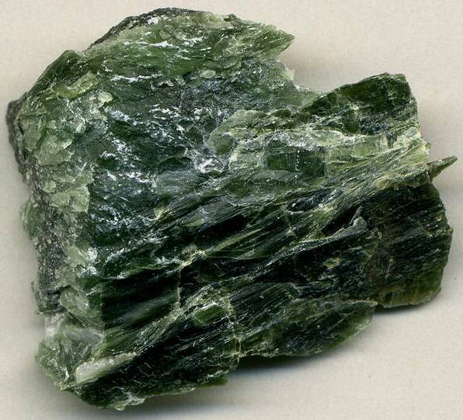
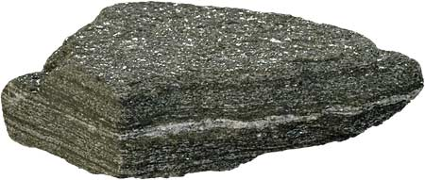
serpentinite
schistes lustrés = glossy schists (presence of mica)
Notes:
In the nappe stack of Alpine Corsica, high-pressure ophiolitic rocks and non-metamorphic rocks are overthrust on top of external (mainly granitic) units. Radiometric ages of the high-pressure rocks in Alpine Corsica indicate that metamorphism took place during the Late Cretaceous and Tertiary (Jolivet et al. 1998, Brunet et al. 2000 and references therein), at the same time when high-pressure metamorphism occurred in the western Alps. Structural evidence shows that Alpine Corsica was thrust over the Hercynian basement with a westward sense of movement and that these structures are overprinted by younger extensional structures with eastward sense of shear (Fournier et al. 1991). Extensional deformation occurred at greenschist-facies conditions and is defined in localised shear zones along extensional detachments (Fournier et al. 1991, Daniel et al. 1996). This style of extension led to isothermal exhumation of the metamorphic core complex now preserved in northeast Corsica (Jolivet et al. 1990, Fournier et al. 1991). An age of ~32 Ma has been estimated as the commencement of extensional deformation in Corsica (Brunet et al. 2000). During Palaeocene to Early Oligocene times, hinterland and foreland directed thrusts and folds developed in Alpine Corsica in response to the collision of the European continental plate and oceanic crust adjacent to the Adria promontory. The 'Nappes Supérieures' represent fragments of the oceanic lithosphere, emplaced toward the west upon the Eoalpine Schistes lustrés nappes and Hercynian continental basement. The 'Nappes Supérieures' were unaffected by syn-tectonic metamorphism, whilst the underlying Schistes lustrés nappes developed a greenschist facies replacement of blueschist parageneses and the foreland basement of Hercynian Corsica developed prehnite–pumpellyite facies assemblages. Serpentinite is a rock composed of one or more serpentine group minerals, the name originating from the similarity of the texture of the rock to that of the skin of a snake. Minerals in this group are formed by serpentinization, a hydration and metamorphic transformation of ultramafic rock from the Earth's mantle.

Slide 6
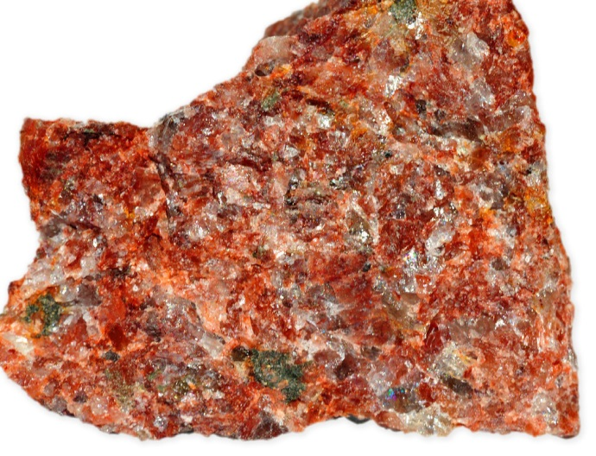
Hercynian or crystalline Corsica
Rocks with greater than 90% felsic minerals can also be called leucocratic, meaning 'light-coloured'.
Batholith formation in a continental collision
Feldspar-rich pink granite from Ile Rousse
Granites in Hercynian Corsica sprang into being about 250 million years ago, when geological upheavals threw up the batholith which forms the backbone of the island
Notes:
Rocks of Palaeozoic age are confined to Hercynian Corsica except where slices of the Hercynian basement have been caught up within the Alpine schists. Most of the Hercynian basement is composed of a vast, compound granite batholith more than 400 km long , running from the SE of Sardinia to the NW of Corsica and intruded during the Lower Carboniferous. The country rock into which these granites was intruded is pre served in very few places in Corsica and consists of Pre cambrian gneisses and Lower Palaeozoic sediments. The Corsardinian granites are overlain unconformably by U. Carboniferous sediments and locally by a thick series of acid extrusives and volcaniclastics of Lowe r Permian age . Another not able feature of this Permian igneous activity is a
series of ring dykes which cut the granite (Maluski

Slide 7
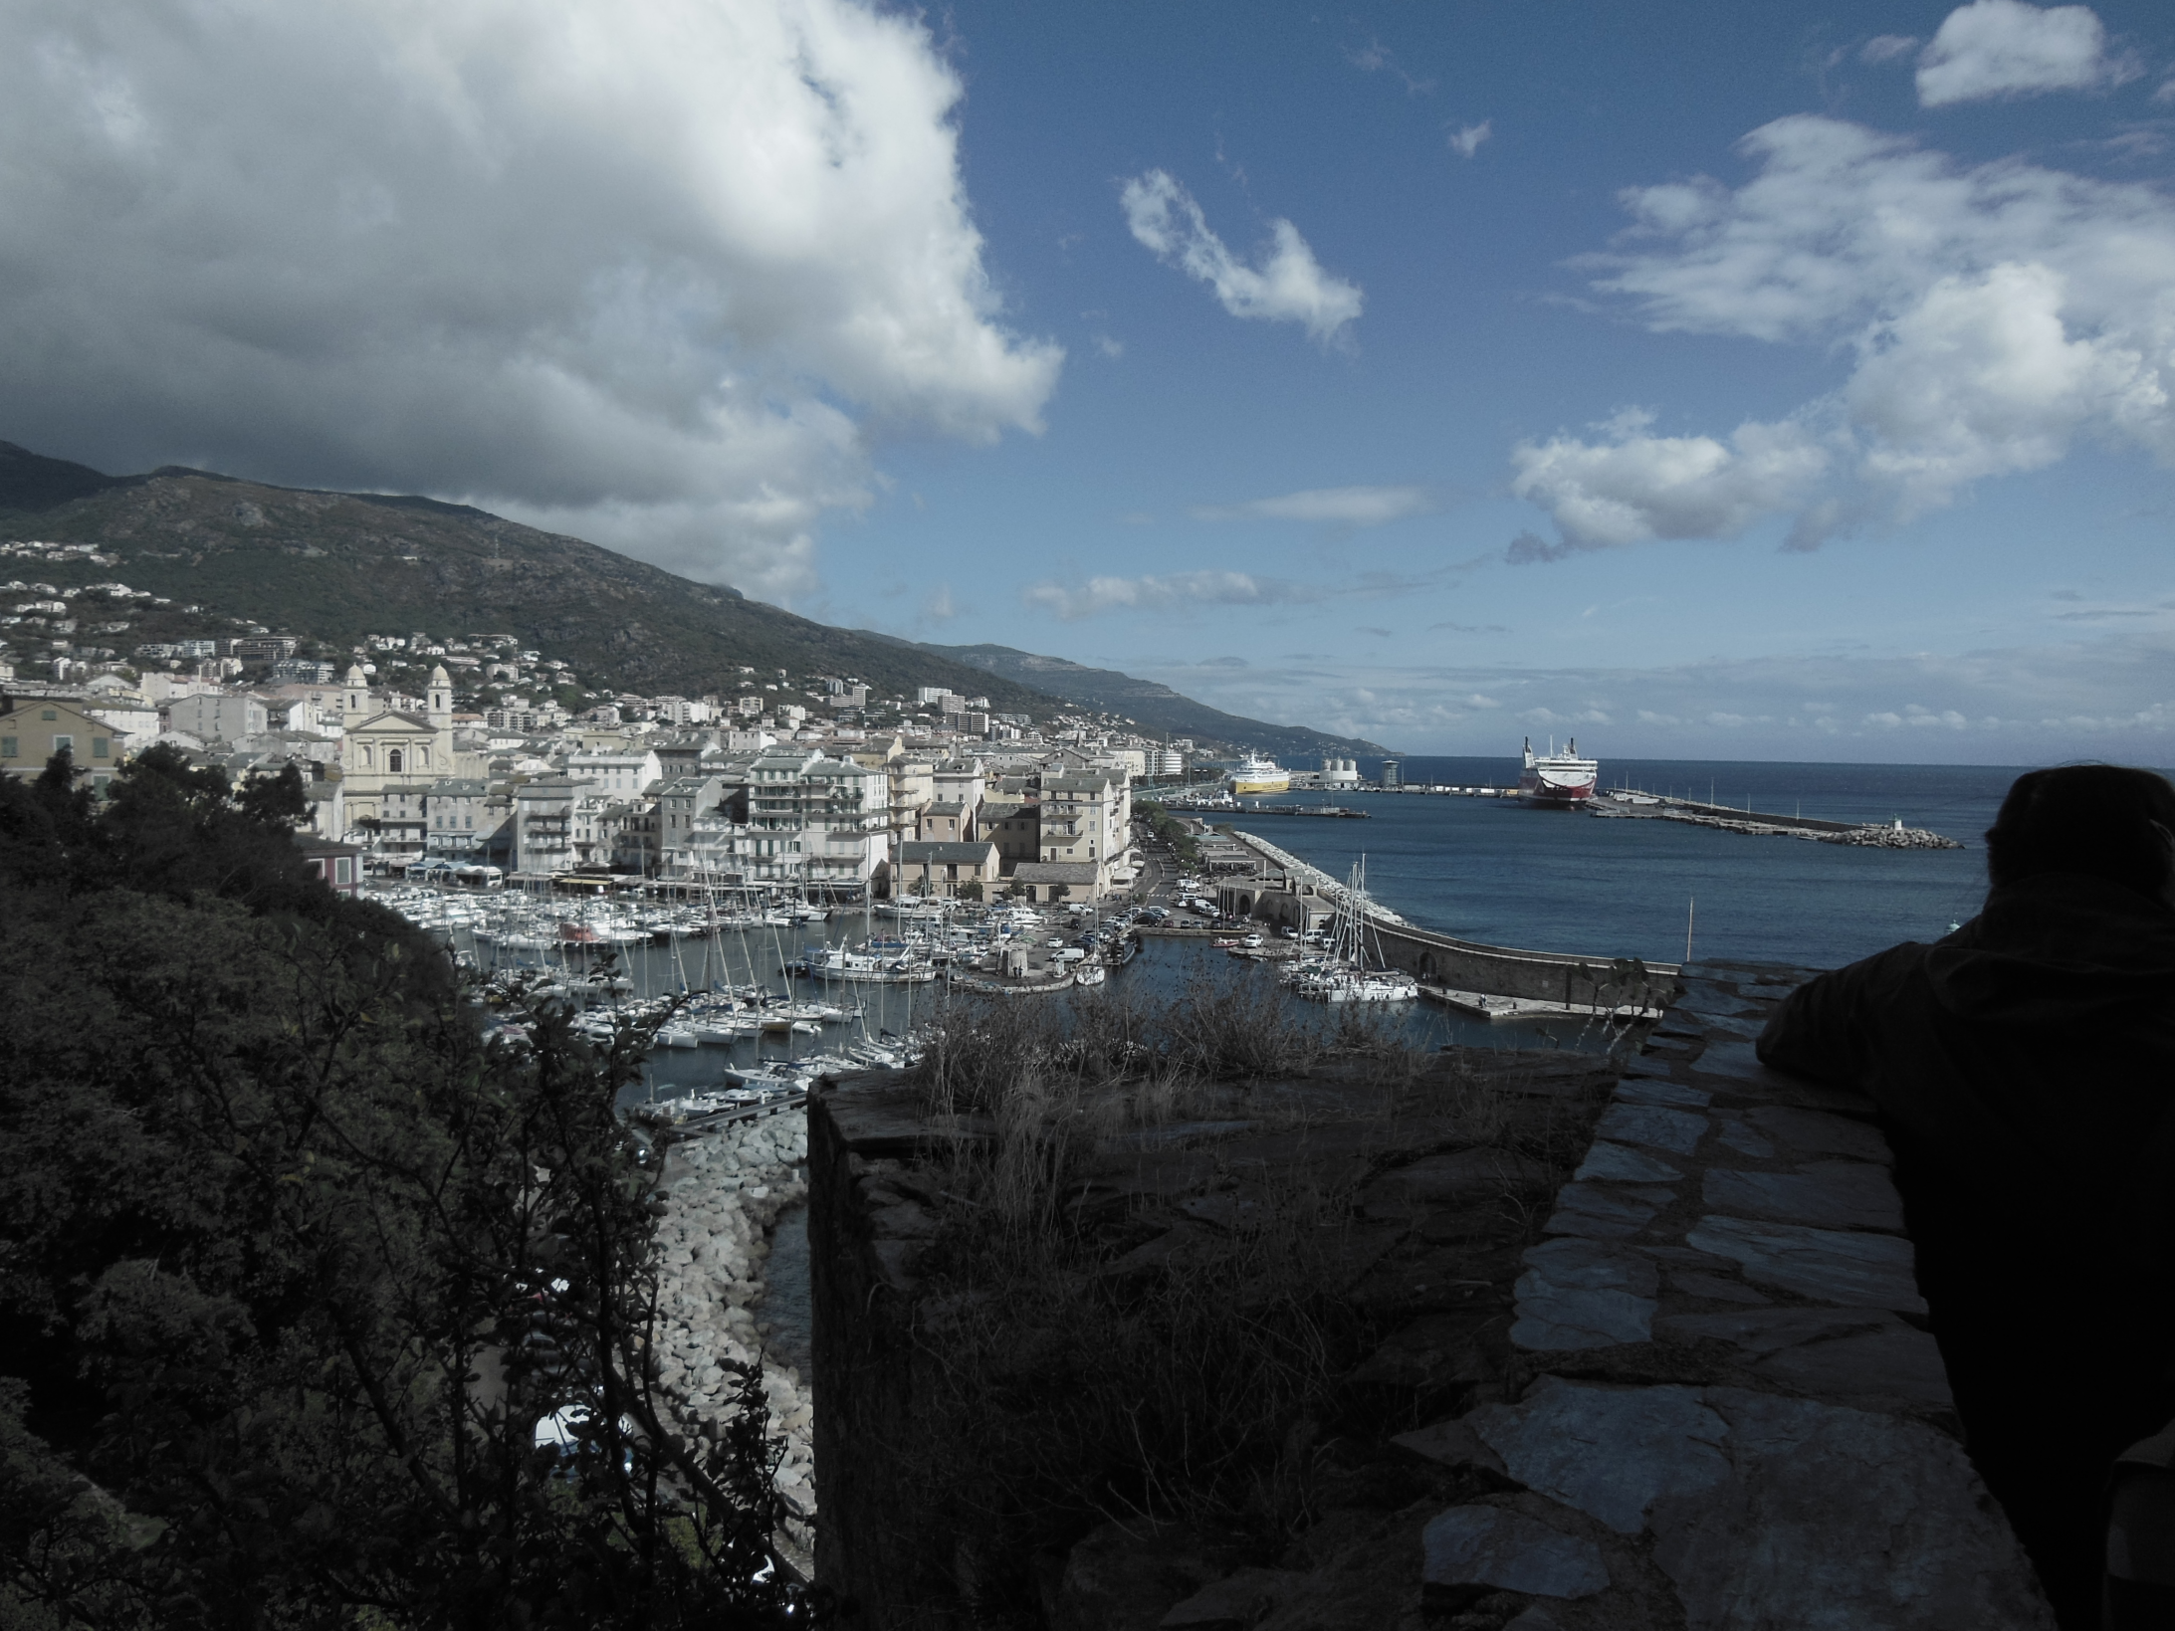
Bastia: Vieux Port looking north
Notes:
Bastia from the Cittadella. On north-east coast in Alpine Corsica. Important ferry port.

Slide 8
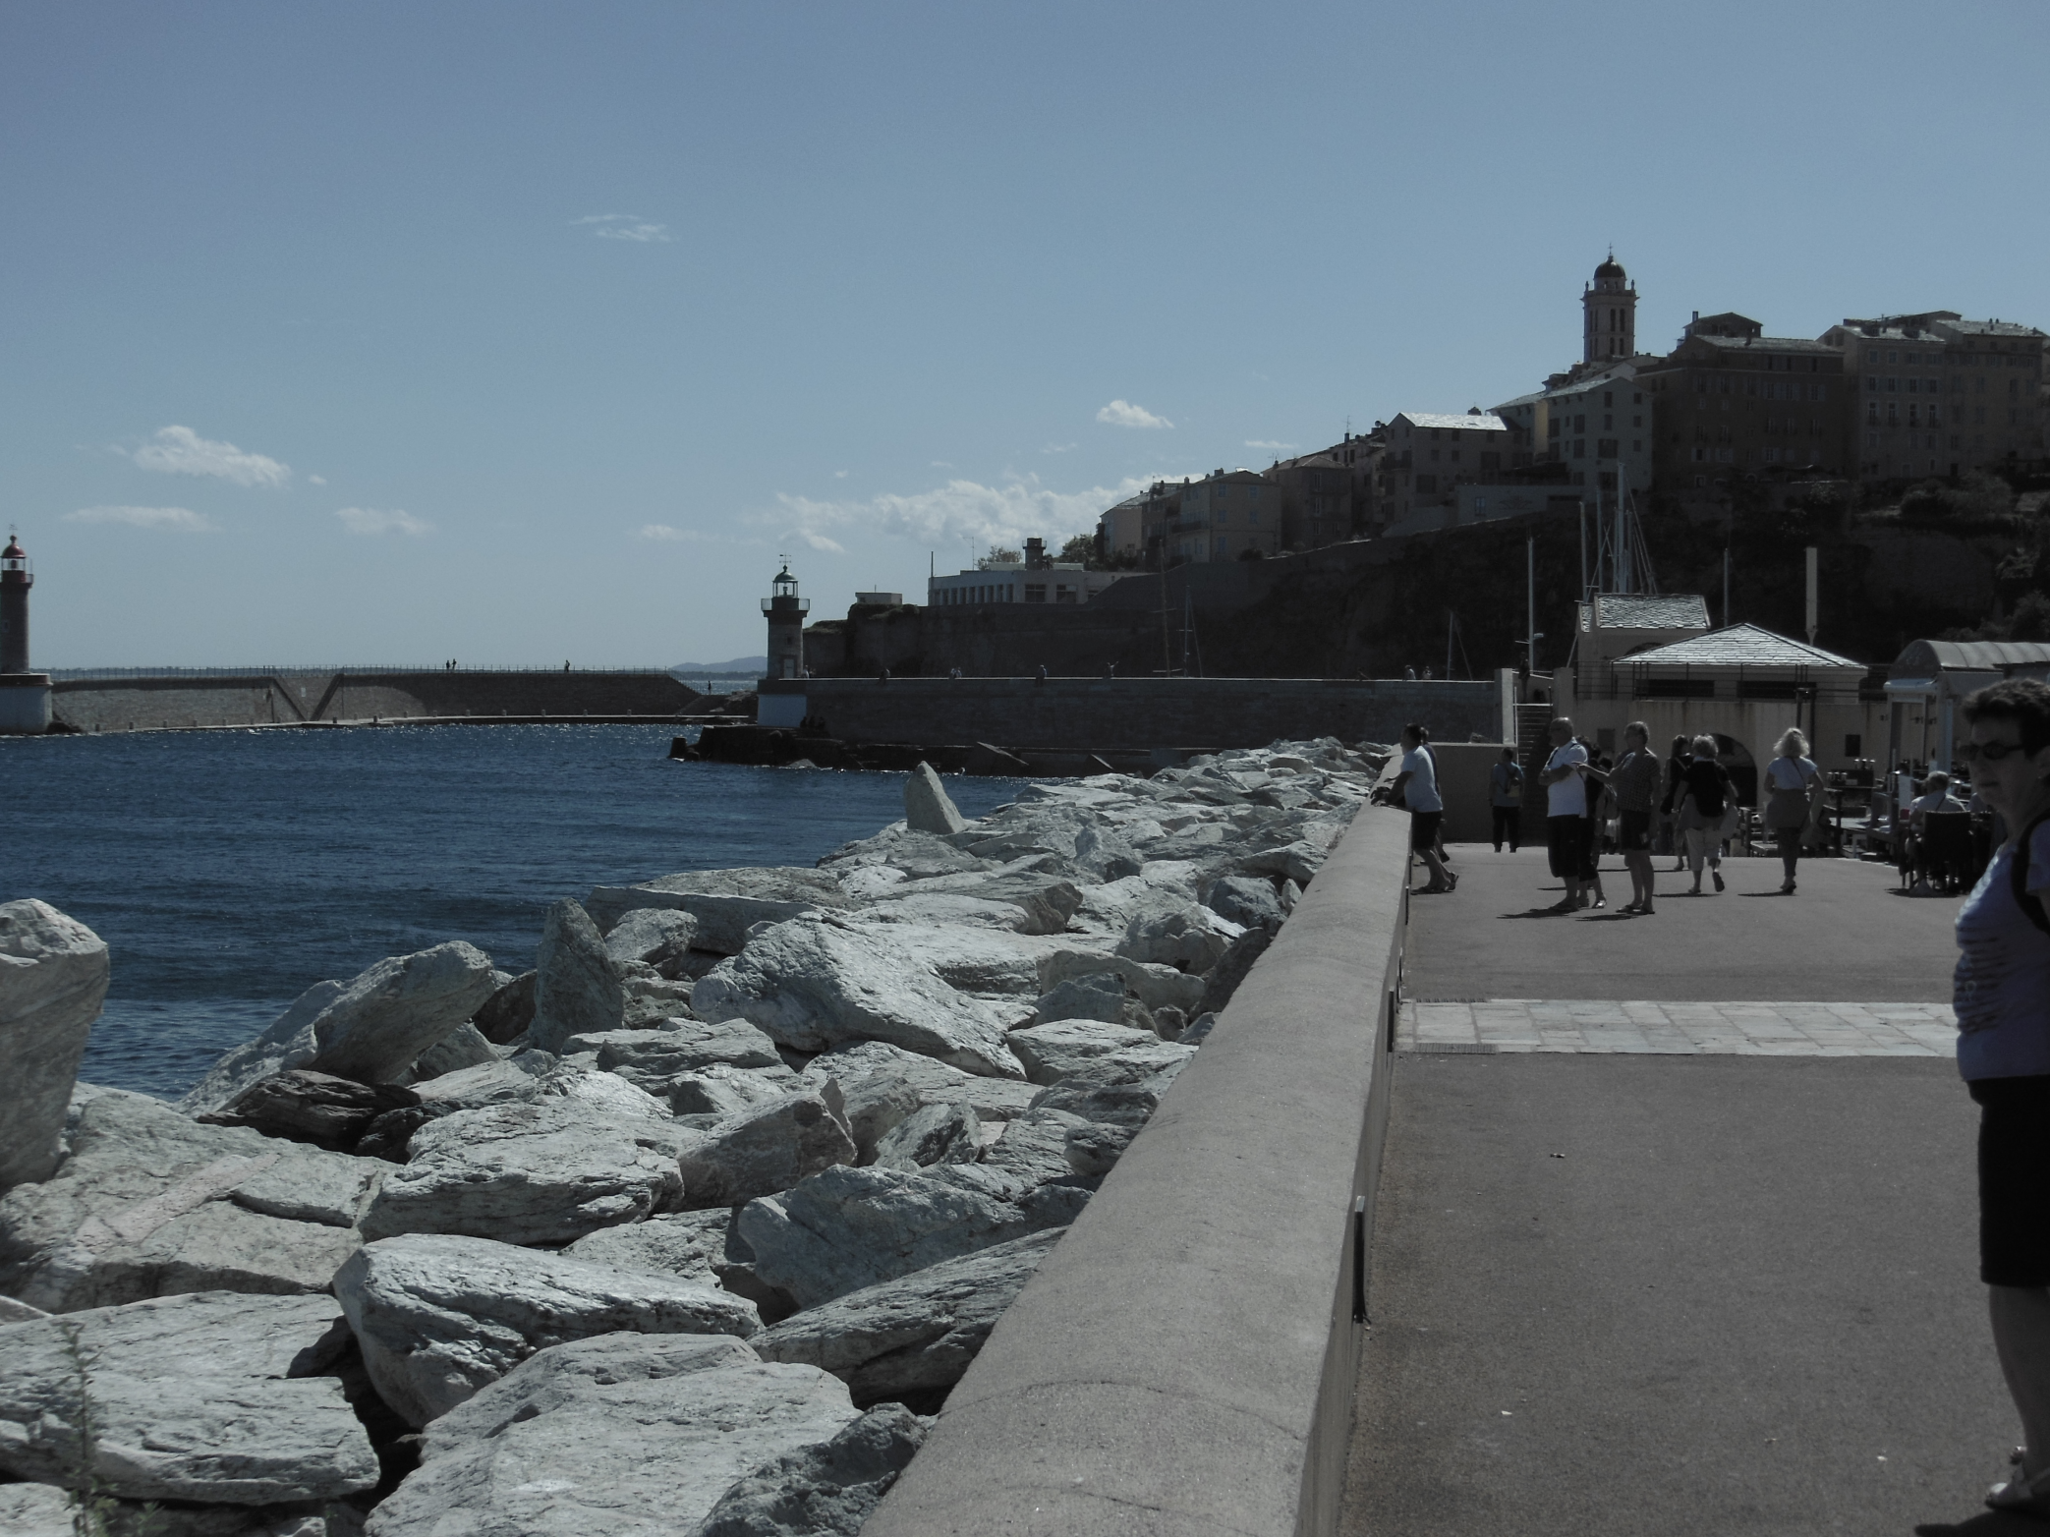
Local schists used as rock armour near the Vieux Port in Bastia
Notes:
Local Schists used as rock armour near the Vieux port in Bastia

Slide 9
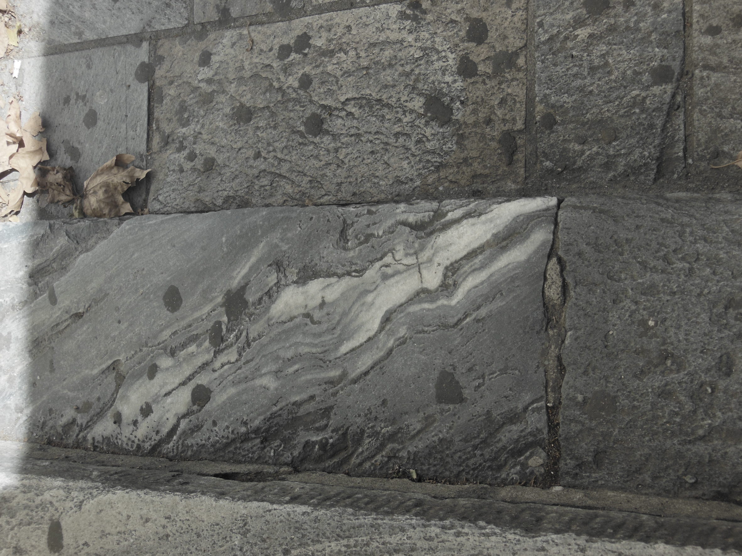
Walling with Schists with quartz-veining in central Bastia
Notes:
Walling with Schists with quartz-veining in central Bastia

Slide 10
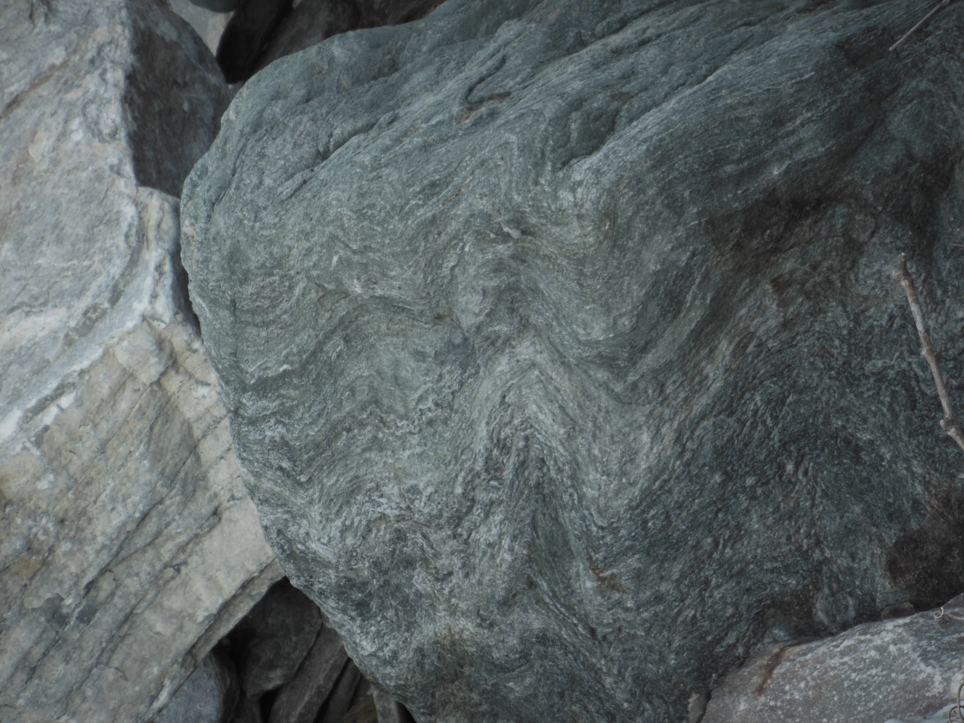
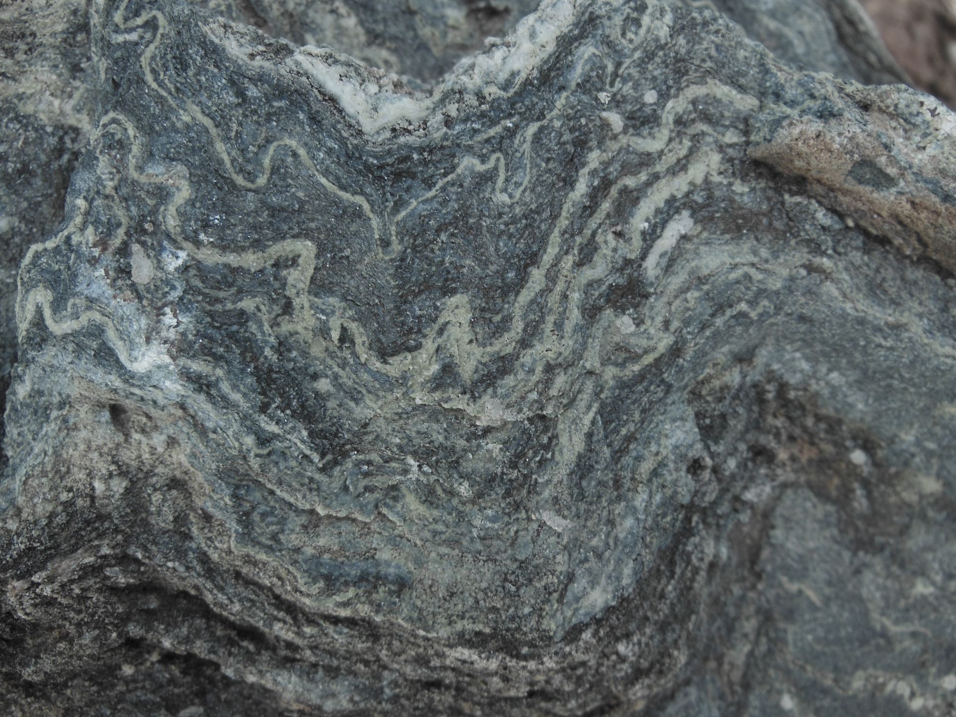
Many of these schists show evidence for several phases of deformation. These specimens are from the beach at Erbalunga
Notes:
Poly-deformed schists Brbalunga beach

Slide 11
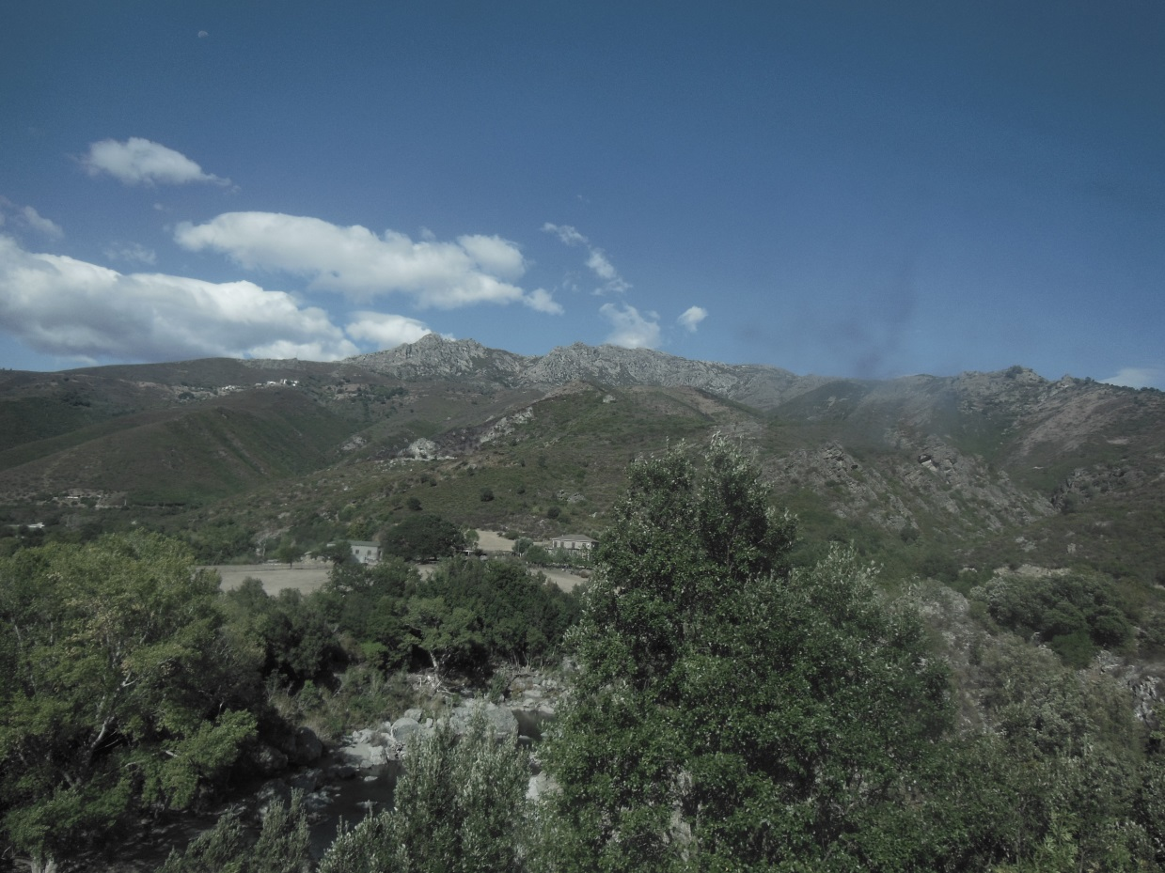
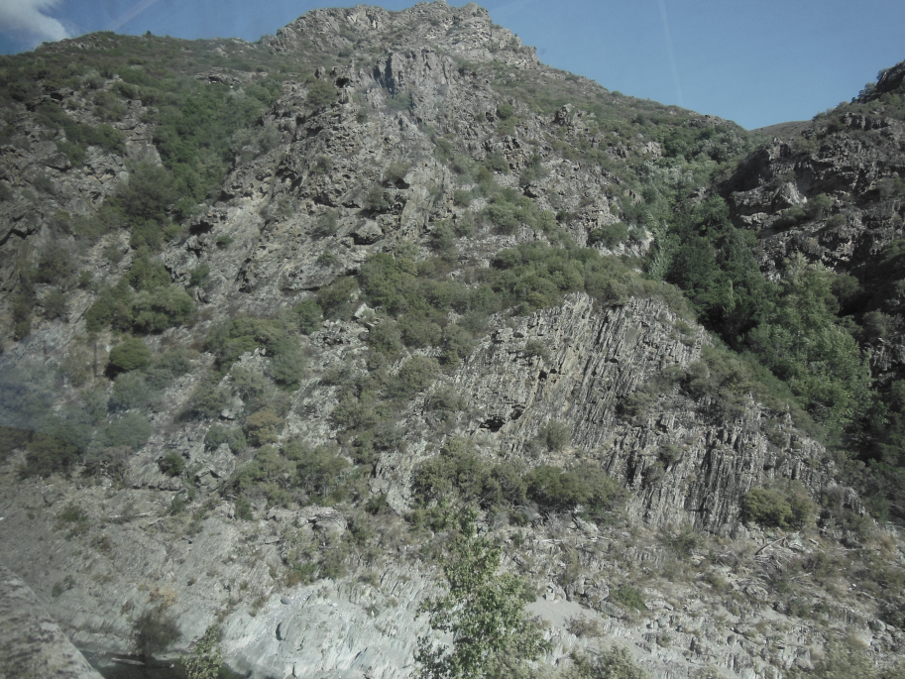
General view of Alpine Corsica’s landscapes from the train. Note the steeply dipping outcrop of schists.
Notes:
General view of Alpine Corsica’s landscapes from the train

Slide 12
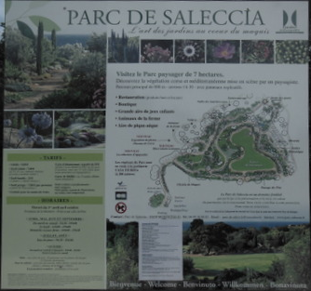
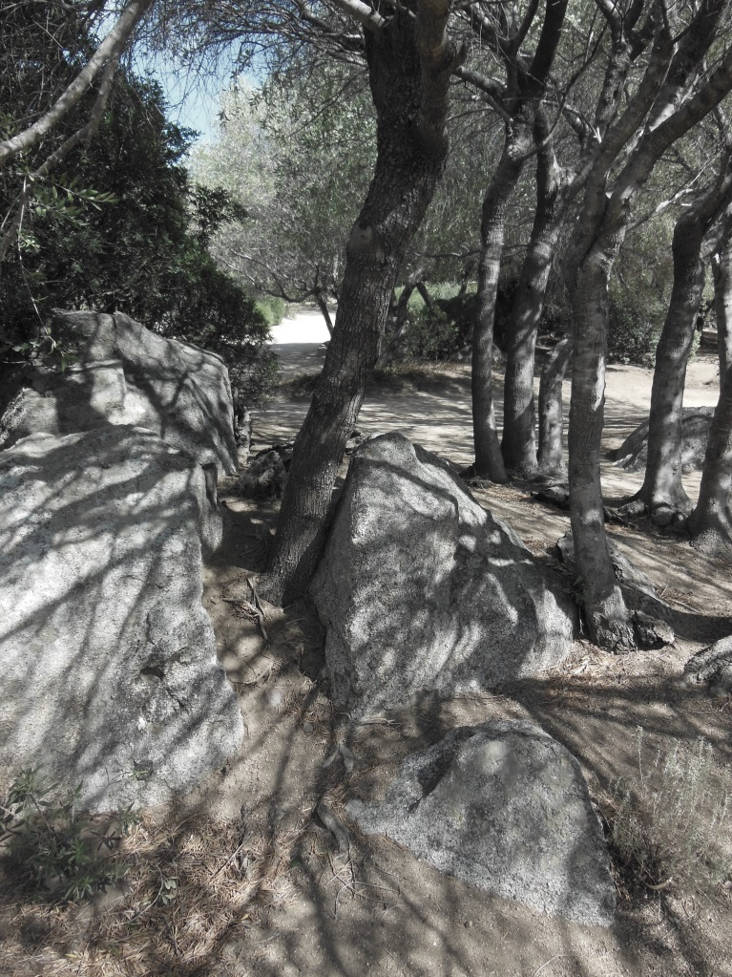
Granite outcrop with biological weathering!
Botanic gardens of Mediterranean plants near Ile Rousse

Slide 13
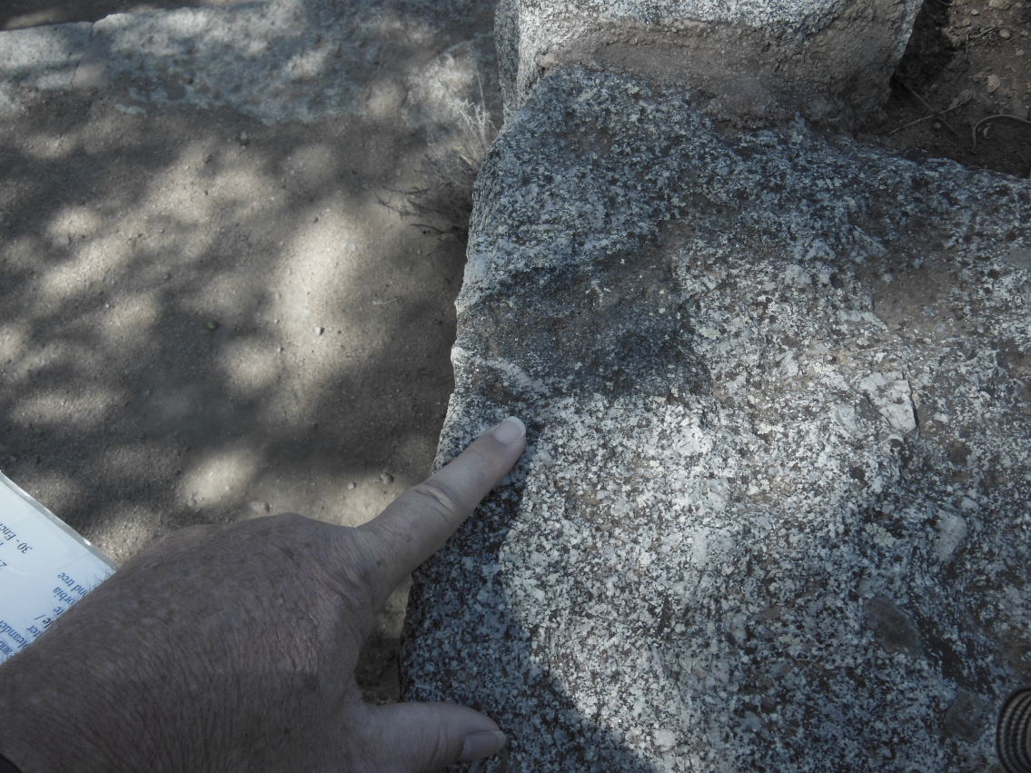
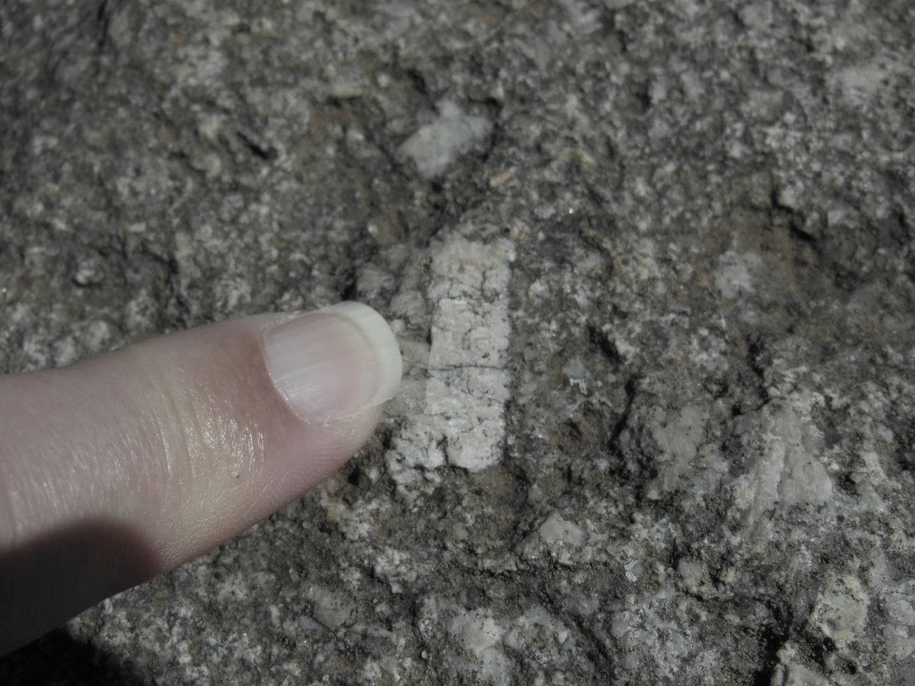
Granites in Parc de Saleccia showing phenocrysts of 1) feldspar and 2) xenoliths

Slide 14
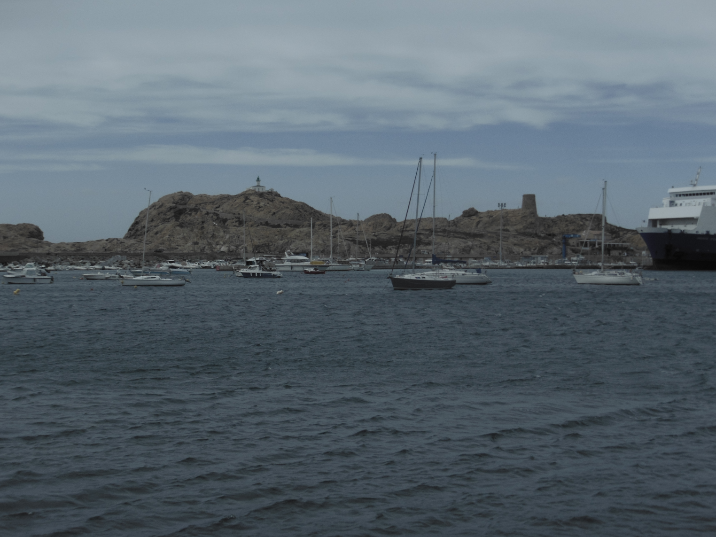
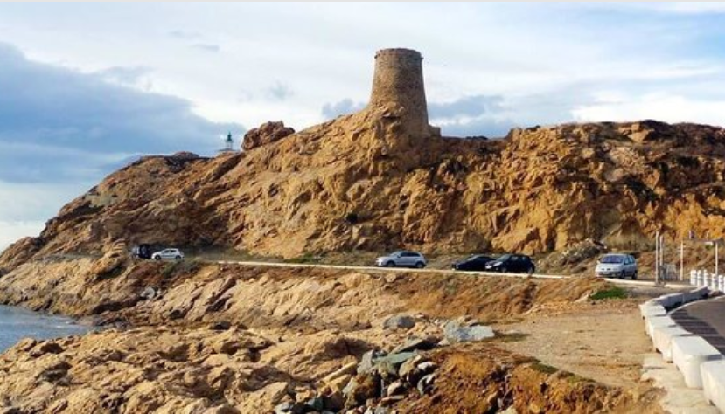
Ile Rousse,named after exposures of leucocratic pinkish granite, with little quartz and much pink (orthoclase) feldspar. Syenite??
Notes:
Ile Rousse,named after exposures of leucocratic red granite, with little quartz and much pink (orthoclase) feldspar

Slide 15
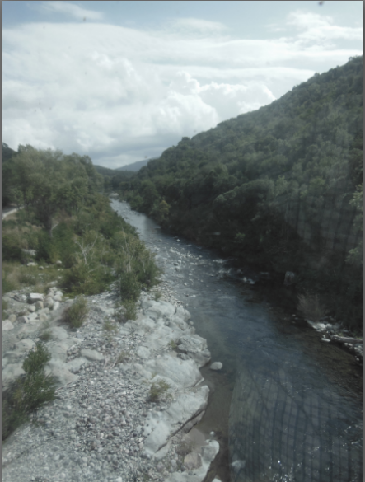
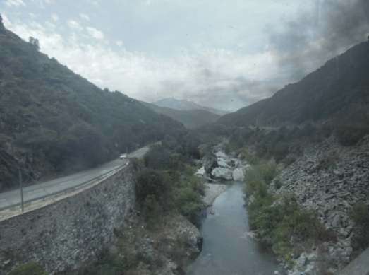
A journey to Corte, in the heart of Corsica. The island’s high rainfall has resulted in the rivers eroding steep-sided valleys and gorges.
Notes:
A journey to Corte, in the heart of granite Corsica. The island’s high rainfall has resulted in the rivers eroding steep-sided valleys and gorges.

Slide 16
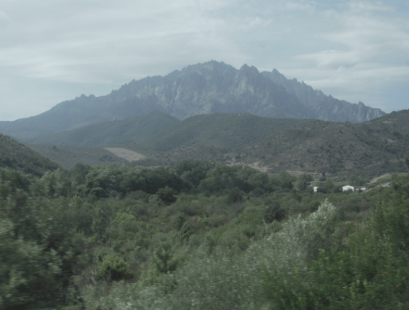
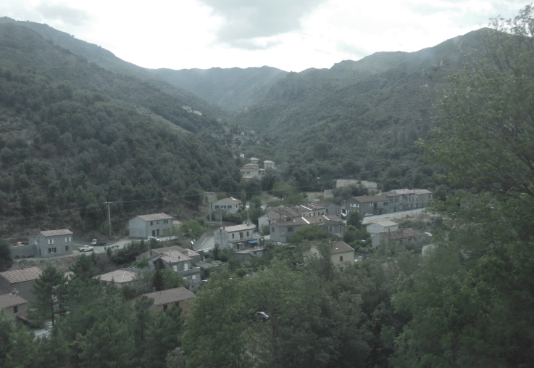
The island’s high rainfall has resulted in the rivers eroding steep-sided valleys and gorges.

Slide 17
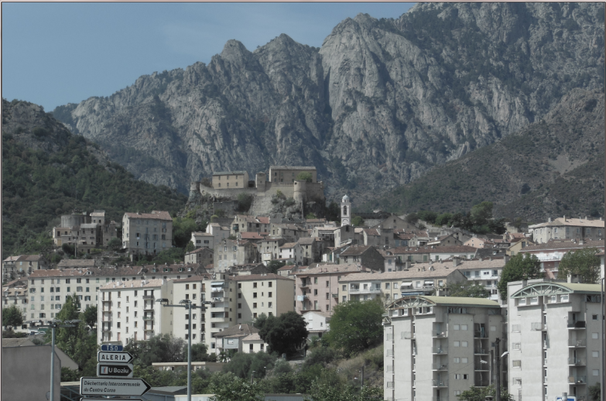
Finally , one reaches the historic town of Corte , built on schistes lustres just east of the granite mountains of central Corsica.
Notes:
Corte Situated in the geographical and cultural heart of Corsica, Corte has played a central role in the island's history. The town is dominated by a majestic citadel, built in 1420 during a short period of Aragonese sovereignty. The citadel ,recently vacated by the Foreign Legion, symbolises Corte's historical role as a centre for resistance. After the building of the citadel Corte twice suffered capture by the Genoese and in 1734 it was taken by the French Army . Retaken by the Corsicans in 1745, Corte became the capital of a short lived independent nation (1755 to 1769) , when Pascal Paoli established the island government and a university. The old town clings to the steep slope below the citadel , the slope emphasising the height of the buildings and especially of the church. The focus of the old town is the Place Paoli , a small square dominated by a statue of the patriot. At the top of the town there are fine views from the Belvedere.

Slide 18
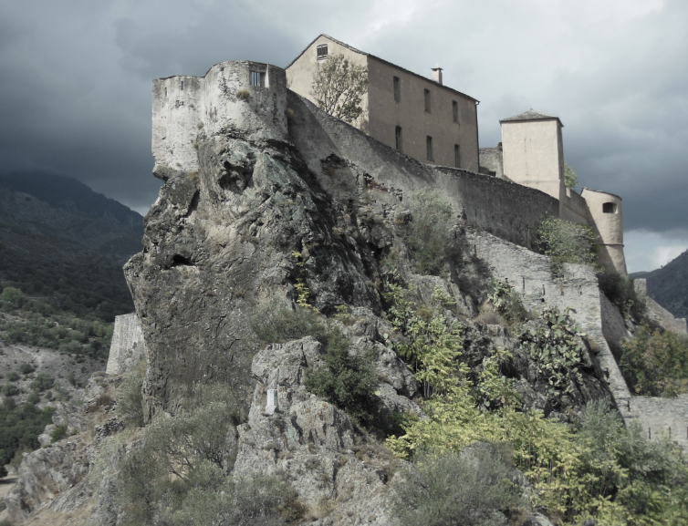
The citadel, built on an outcrop of schistes lustres.

Slide 19
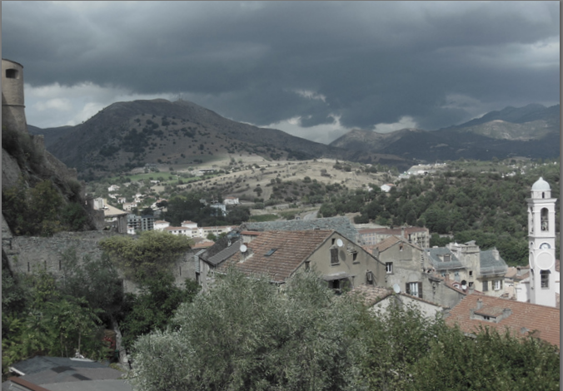
View westwards from the citadel, towards the granite highlands

Slide 20
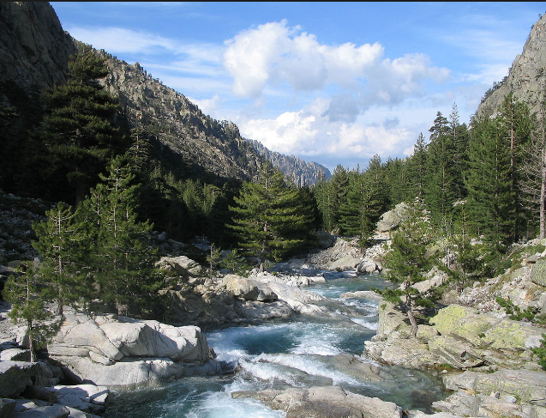
Gorges du Restonica, a granite gorge
west of Corte
Notes:
Tavignano and Restonica granite gorges west of Corte

Slide 21
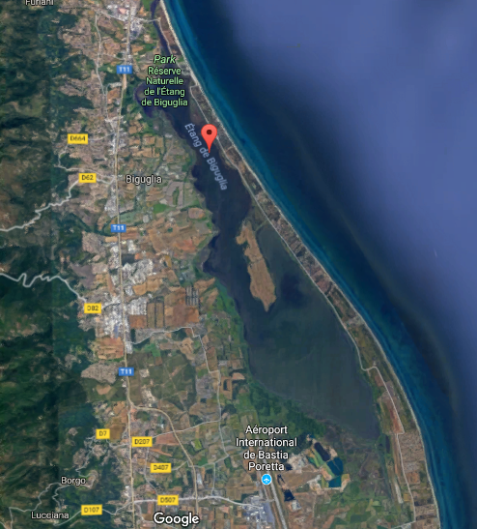
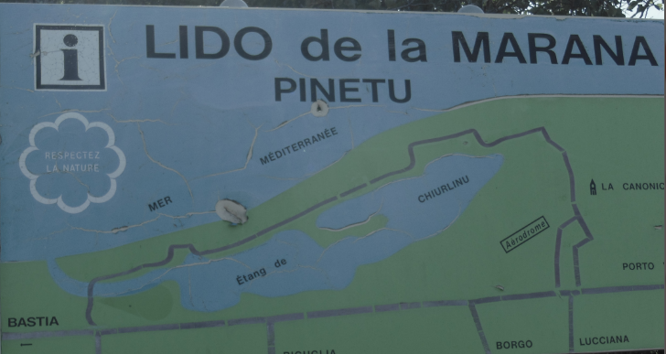
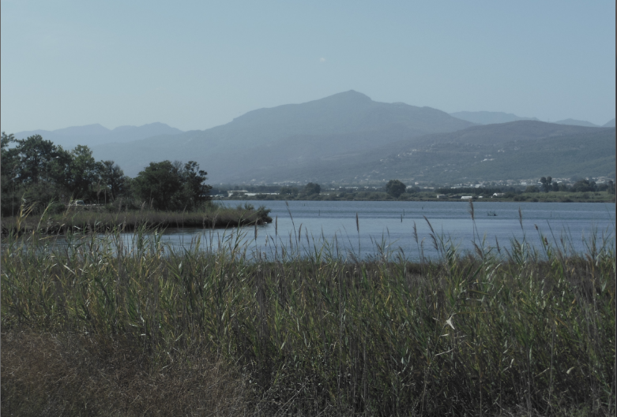
The etang (lagoon) of Biguglia (or Chiurlino) and the Lido de Marana, an impressive barrier beach south of Bastia
Notes:
The lagoon of Biguglia (or Chiurlino ) is located south of Bastia , on the Bevinco river .The pond of Biguglia is the largest coastal lagoon of the island It covers 1,450 ha , with a length of 11 km from north to south for a maximum width of 2.5 km . Its average depth is 1 m . It occupies most of the plain of Marana , along a coastline less than one kilometer wide that separates it from the Tyrrhenian Sea . The watershed of the pond is located on an area of ​​lustrous schists and ancient alluvial deposits. It is fed by five streams: Bevinco River, Borgogna Trench, Pietre Turchine Creek, Rasignani Creek and Mormorana Creek. it appeared by sea resurfacing of the alluvium of Golo ; its peripheries are composed of recent alluviums, with the exception of San Damianu Island, a task of ancient alluvial deposits, and the Marana lido, made up of sands. The Biguglia pond was formerly officially called Chiurlino Pond ( Chjurlinu ), its original name. This toponym is still widely used today by the Corsicans.

Slide 22
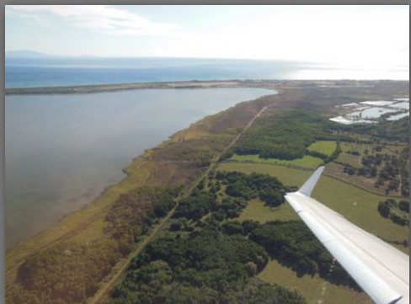
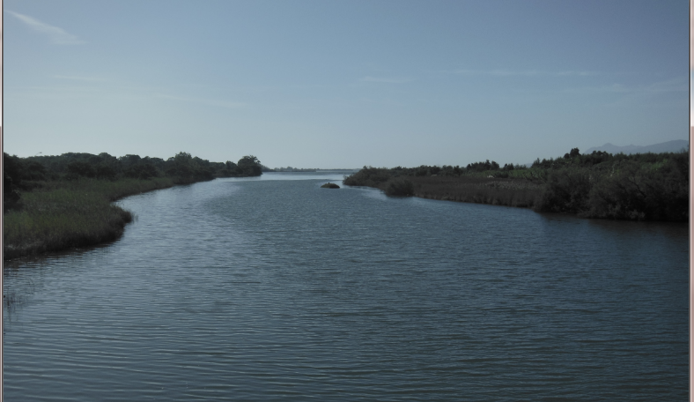
The lagoon of Biguglia and a last look at Corsica on the way home!

