Slide 1
Holiday Rocks 2020 Holiday Down Under
Some highlights from a visit to
New Zealand
© Alan Holiday 2020

Slide 2
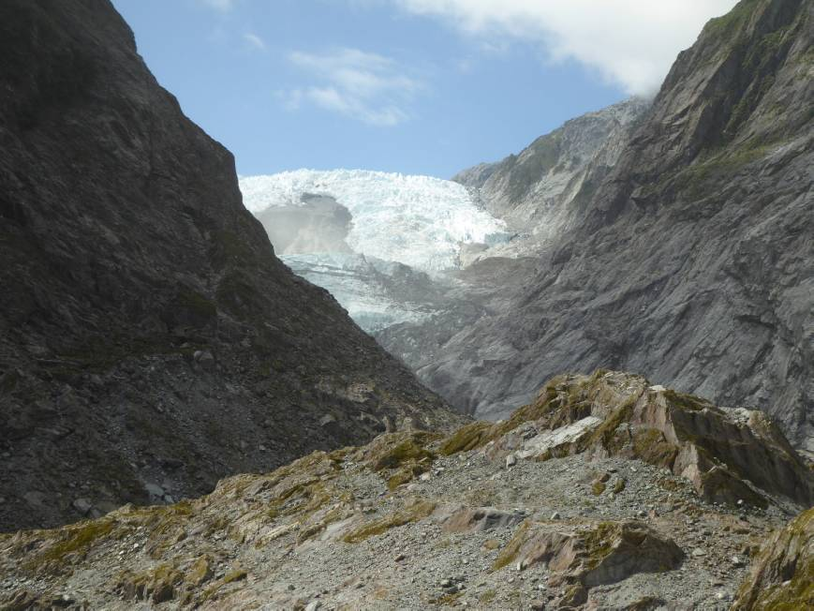
Franz Josef Glacier, South Island.

Slide 3
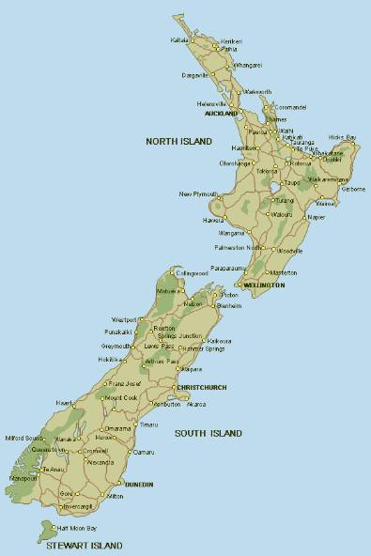
What we did!
We visited New Zealand from January 29th to March 8th starting our visit in Christchurch. We did a circuit of South Island before taking the ferry from Picton to Wellington and touring parts of North Island we missed in 2012.

Slide 4
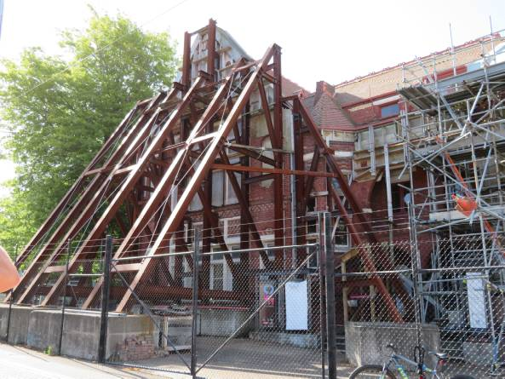
Earthquake damage in Christchurch is still visible.
Two major earthquakes occurred in September 2010 (magnitude 7.1) and June 2011 (magnitude 6.0) with epicentres in the Christchurch area.

Slide 5
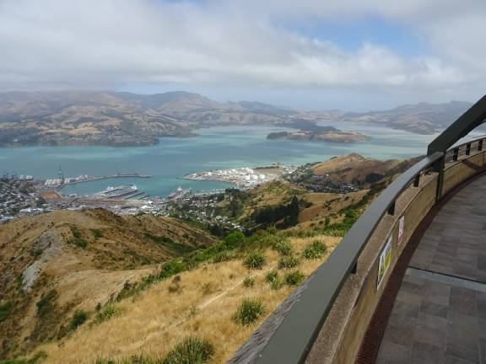
We visited Mount Pleasant using the cable car.
View of Lyttleton Harbour, Banks Peninsula from the top of the cable car.

Slide 6
The Banks Peninsula is a volcanic complex of Cretaceous and Miocene lavas.

Slide 7
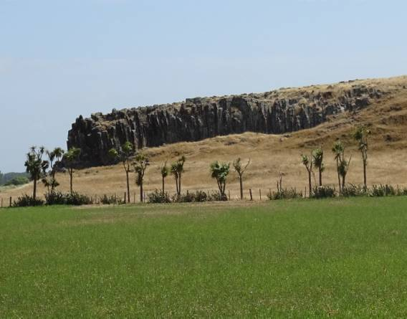
No quakes when we visited but plenty of evidence of past volcanic activity.
Columnar jointing in basalt lava flow(?) near Birdlings Flat.

Slide 8
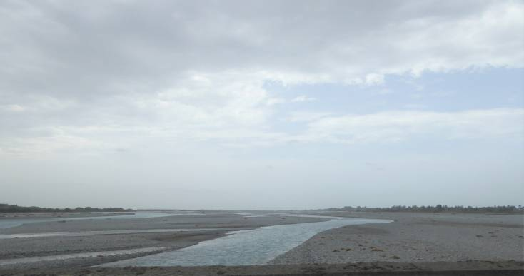
We then drove south across the Canterbury Plains, limited exposure!
Rakaia River with extensive braided channels transporting sediment from the Southern Alps.

Slide 9
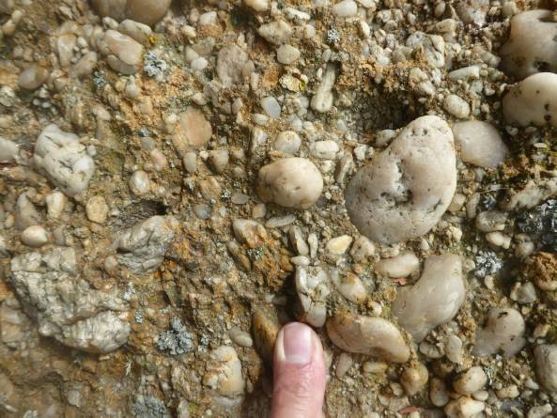
Nice example of quartz conglomerate near the Waitaki River north of Oamaru.

Slide 10
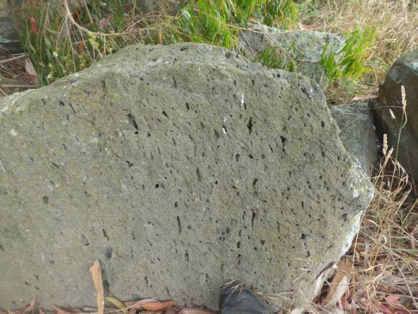
Nearby good example of vesicular basalt being used as rock armour.
Evidence of stretching of vesicles suggesting evidence of flow during cooling.

Slide 11
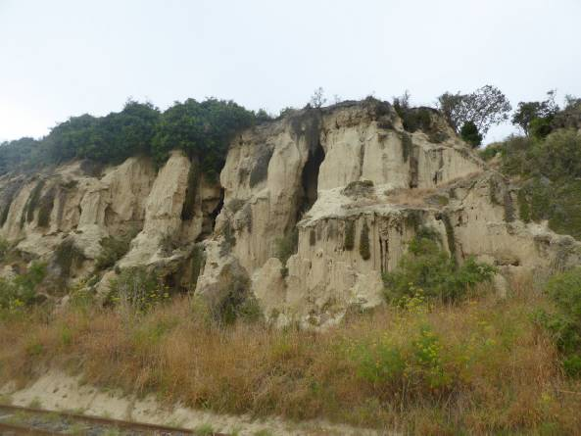
First stop after Christchurch was Oamaru.
Eocene limestone near Oamaru harbour, much eroded!

Slide 12
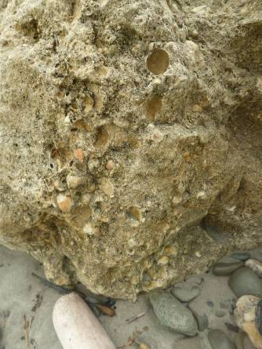
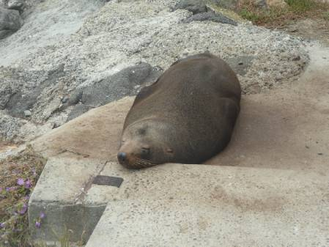
Brachiopod coquina on beach south of Oamaru. Also evidence of wildlife!
Oamaru seal colony.
Terebratulid type fauna.

Slide 13
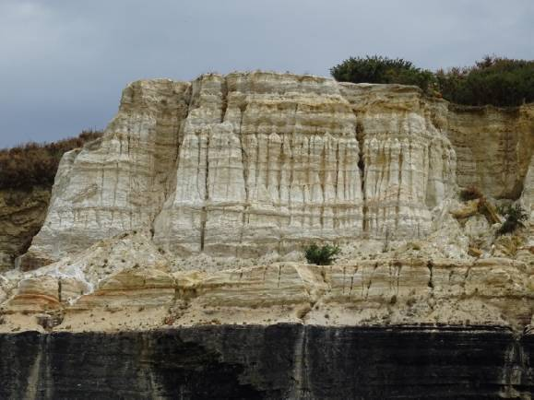
Waitaki Whitestone Geopark.
Inland from Oamaru is a variety of interesting geology which is likely to allow the area to be designated as a geopark.
vanishedworld.co.nz
Oligocene limestone and greensand on the road from Oamaru to Duntroon.

Slide 14
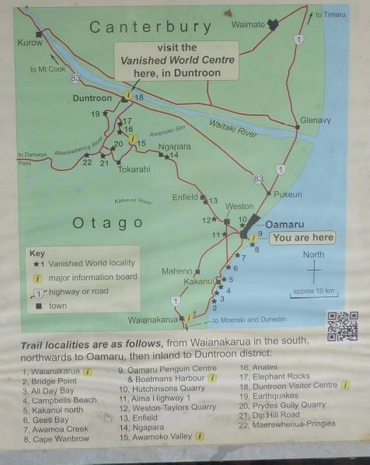
Map of the area of the geopark

Slide 15
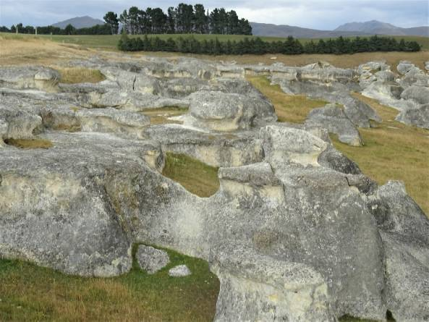
Elephant Rocks – Oligocene limestone.

Slide 16
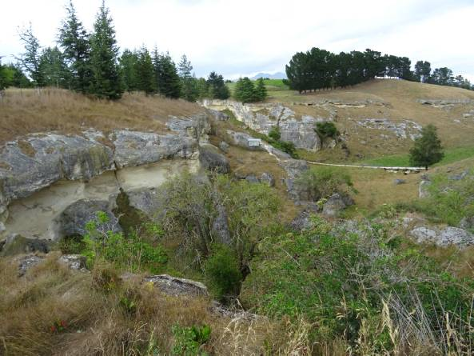
Anatini fossil whale site.

Slide 17
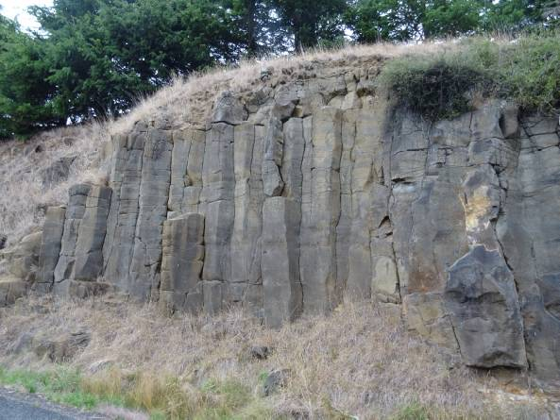
Tokarahi Sill.

Slide 18
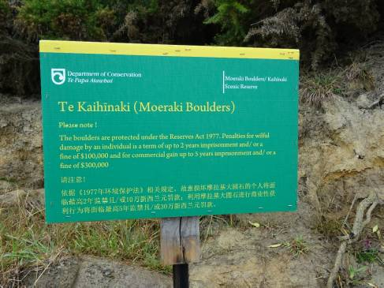
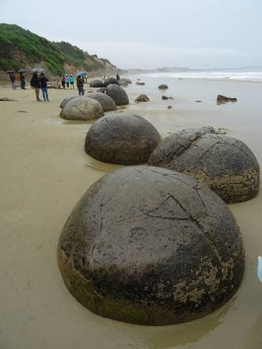
Next stop, the Moeraki Boulders site.
Unfortunately the weather was a little disappointing!

Slide 19
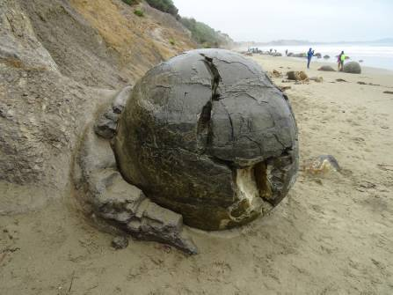
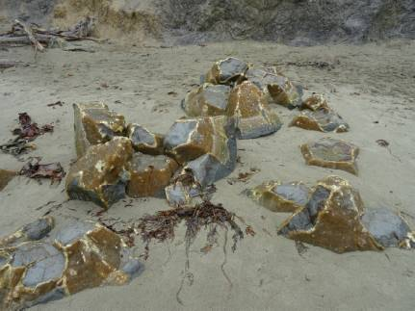
Septarian concretions on a grand scale.

Slide 20
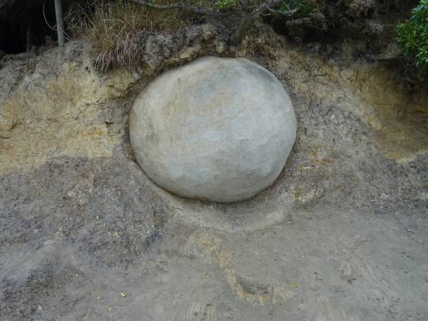
Another concretion weathering out of the cliff.

Slide 21
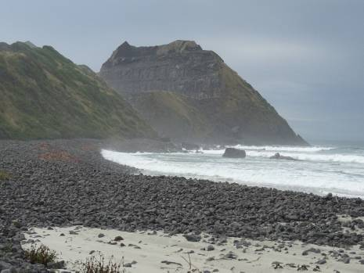
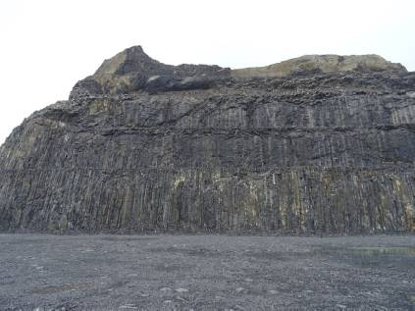
And on to Dunedin.
Black Head basalt quarry showing good columnar jointing.

Slide 22
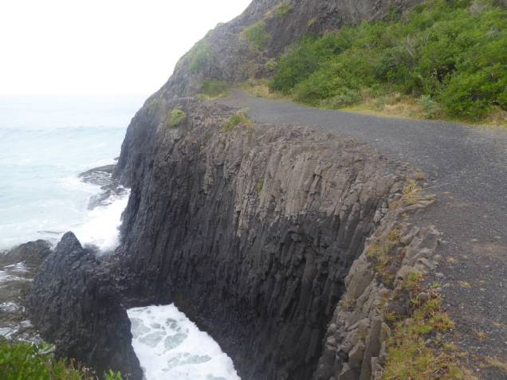
Nearby, St Clair with more basalt…..

Slide 23
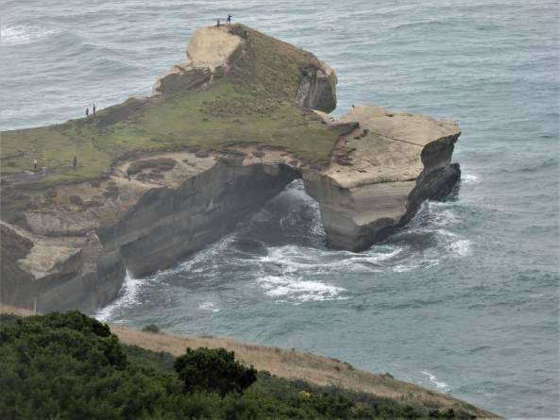
…..and Tunnel Beach.

Slide 24
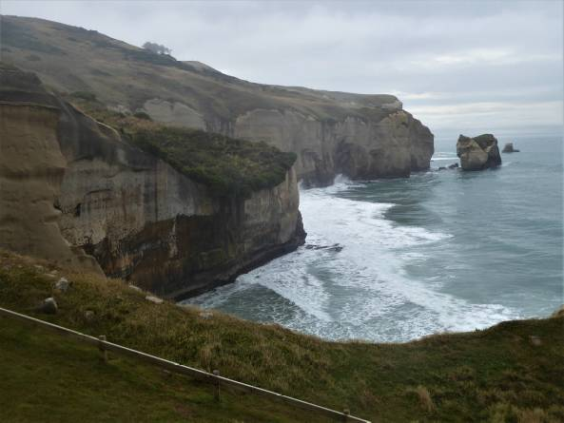
Stacks and arches cut in Miocene sandstone, again disappointing weather.

Slide 25
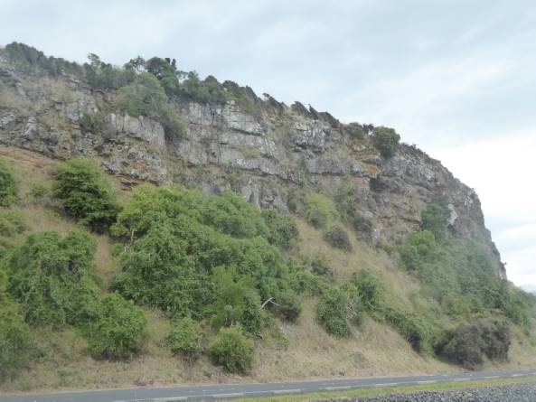
Nearby, Otago Peninsula with more evidence of volcanic activity.

Slide 26
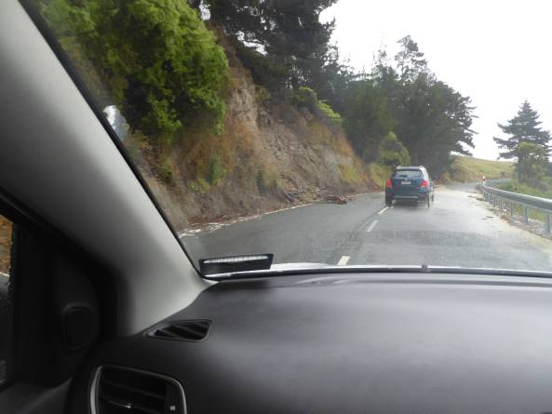
Moving on towards Invercargill via Catlins Scenic Route, the poor weather continued!
Flooded roads and landslides in the poorly consolidated rocks.

Slide 27
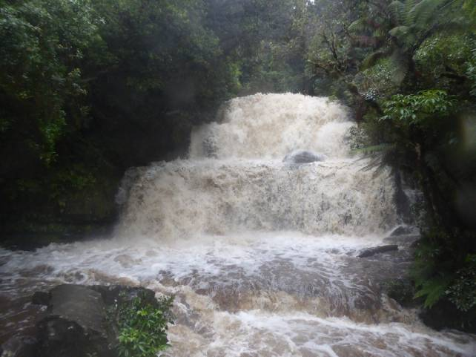
Purakanui Falls, river in spate!

Slide 28
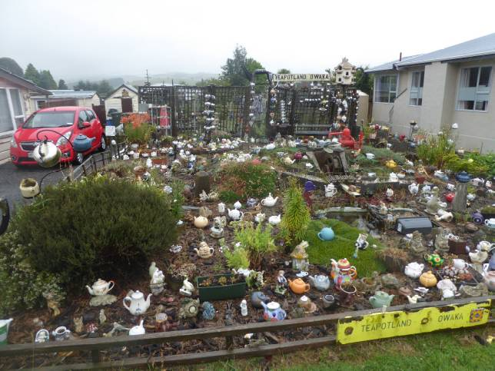
It wasn’t all geology though.

Slide 29
While at Invercargill we visited Bluff.
Panorama from Bluff viewpoint

Slide 30
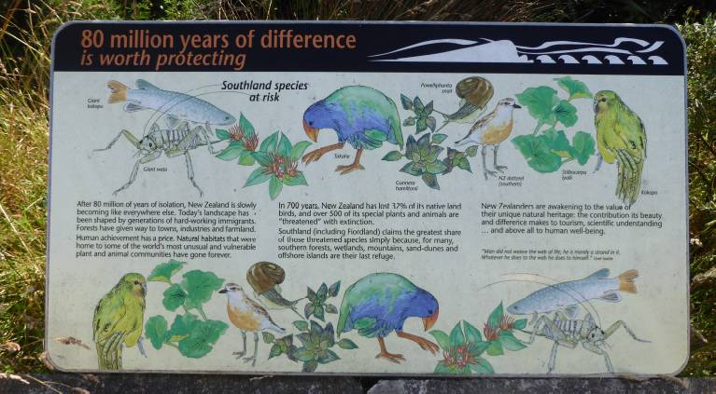
Concern over native species in competition with invaders!

Slide 31
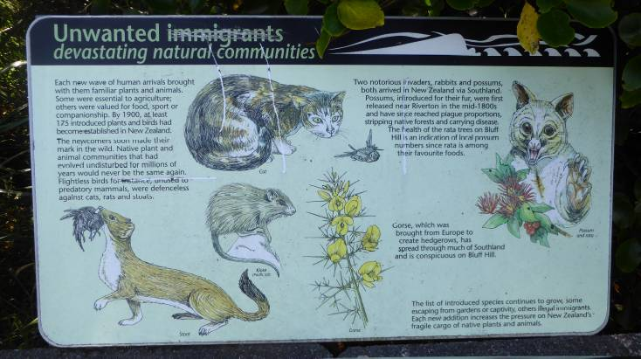
Examples of troublesome invasive species!

Slide 32
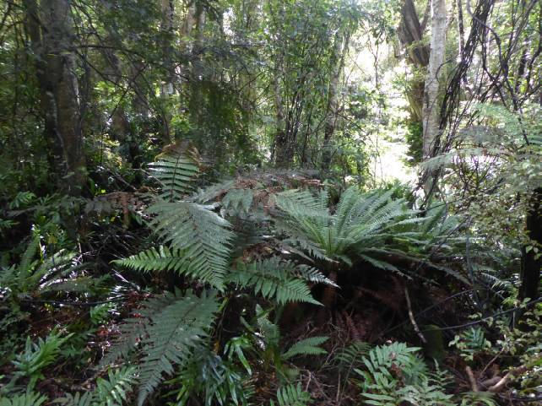
Woodland reserve at Bluff Point.

Slide 33
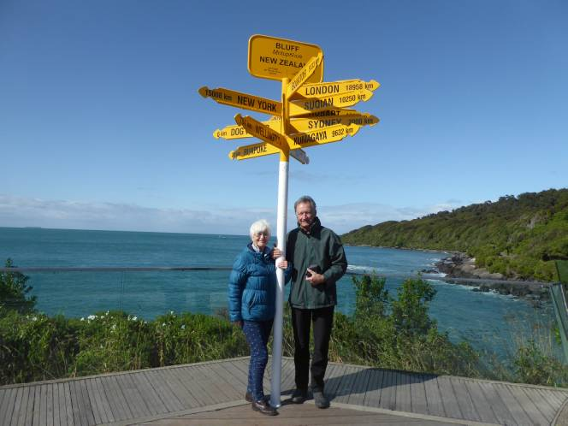
We finally got some sunshine!

Slide 34
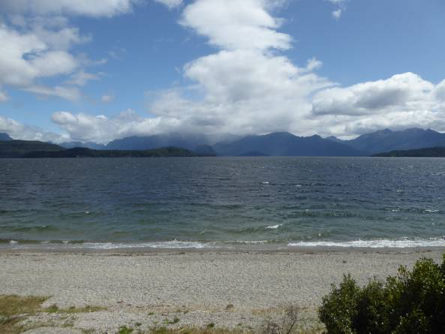
We then drove north to Manapouri.
We had planned to go to Milford Sound but the road was closed due to landslides so we went to Doubtful Sound which was brilliant.

Slide 35
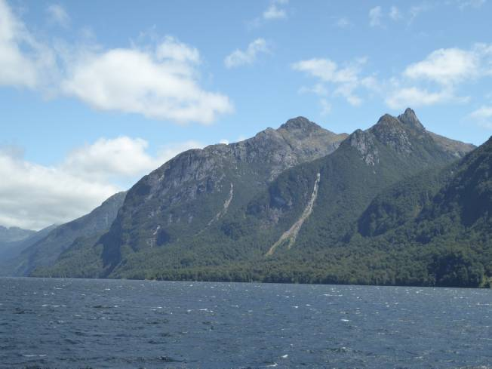
First of all the ferry took us across Lake Manapouri

Slide 36
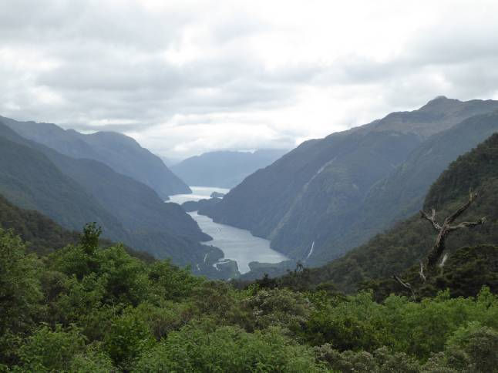
Followed by coach ride to Doubtful Sound.

Slide 37
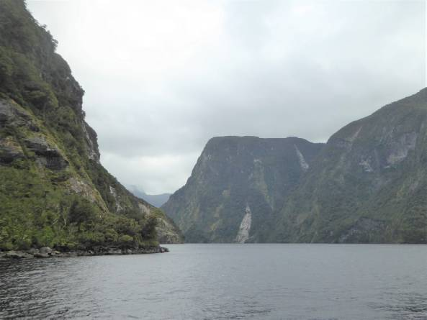
Fabulous fjord scenery, more cloudy nearer the coast.

Slide 38
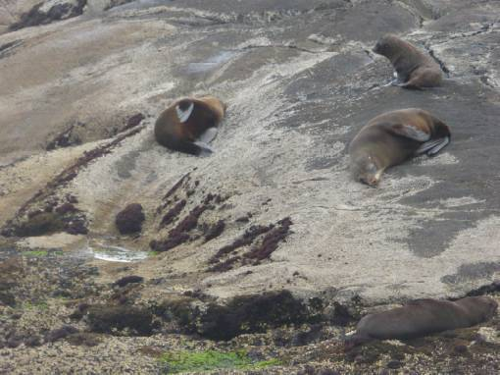
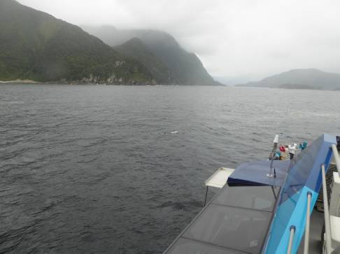
Seal colony at the seaward end and even an albatross!

Slide 39
Sources of information.
https://teara.govt.nz/en/geology-overview/page-1
Field Guide to New Zealand Geology. Jocelyn Thornton. Penguin Books.

